Slide 1
IDEAS Test Build Validation
Build 20210416 vs Build 20210702

Slide 2
Important Build Notes

Slide 3
Overview

Slide 4
Design Tool Functionality Checks
Tool/Program | Pass/Fail
I-Design (idd) / Scale
I-Design (idd) / Modify Cutter/Position
IDEAS Static (ids) / Normal Functionality
IDEAS Static (ids) / Multi-Core processing
IDEAS Dynamic (id3) / Normal Functionality
IDEAS Dynamic (id3) / Multi-Core processing
IDEAS Autoforce (ida) / Force Balance Optimization
IDEAS3 Utility (id3u)
IDEAS Analysis Request (iAR) / Create Projects (ideasbuild20210702)
Bit Design Toolbox / IAR Project Renamer
Bit Design Toolbox / Rollback IDEAS Project
IDM / Create/Run Projectgroup
SAM
Multi-Bit

Slide 5
Static Analysis Results

Slide 6
AxeBlade Static

Slide 7
Profile Comparison

Slide 8
Back Rake/Side Rake Information

Slide 9
Cutter Information

Slide 10
Cutter Information

Slide 11
Static Analysis Results

Slide 12
Static Analysis Results

Slide 13
Static Analysis Results

Slide 14
Static Analysis Results

Slide 15
Static Analysis Results

Slide 16
Static Analysis Results

Slide 17
Static Analysis Results

Slide 18
Static Analysis Results

Slide 19
Static Analysis Results

Slide 20
Static Analysis Results

Slide 21
Static Analysis Results

Slide 22
Static Analysis Results

Slide 23
Static Analysis Results

Slide 24
Static Analysis Results

Slide 25
Static Analysis Results

Slide 26
Static Analysis Results

Slide 27
Static Analysis Results

Slide 28
Static Analysis Results

Slide 29
ROP Comparison

Slide 30
Torque Comparison

Slide 31
ROP/Torque Comparison

Slide 32
Bit Advance Comparison

Slide 33
Total Imbalance Force Comparison

Slide 34
Beta Angle Comparison

Slide 35
Circumferential Imbalance Force Comparison

Slide 36
Radial Imbalance Force Comparison

Slide 37
Normalized Imbalance Force Ratio Comparison

Slide 38
PDC Static

Slide 39
Profile Comparison

Slide 40
Back Rake/Side Rake Information

Slide 41
Cutter Information

Slide 42
Cutter Information

Slide 43
Static Analysis Results

Slide 44
Static Analysis Results

Slide 45
Static Analysis Results

Slide 46
Static Analysis Results

Slide 47
Static Analysis Results

Slide 48
Static Analysis Results

Slide 49
Static Analysis Results

Slide 50
Static Analysis Results

Slide 51
Static Analysis Results

Slide 52
Static Analysis Results

Slide 53
Static Analysis Results

Slide 54
Static Analysis Results

Slide 55
Static Analysis Results

Slide 56
Static Analysis Results

Slide 57
Static Analysis Results

Slide 58
Static Analysis Results

Slide 59
Static Analysis Results

Slide 60
Static Analysis Results

Slide 61
ROP Comparison

Slide 62
Torque Comparison

Slide 63
ROP/Torque Comparison

Slide 64
Bit Advance Comparison

Slide 65
Total Imbalance Force Comparison

Slide 66
Beta Angle Comparison

Slide 67
Circumferential Imbalance Force Comparison

Slide 68
Radial Imbalance Force Comparison

Slide 69
Normalized Imbalance Force Ratio Comparison

Slide 70
StingBlade Static

Slide 71
Profile Comparison

Slide 72
Back Rake/Side Rake Information

Slide 73
Cutter Information

Slide 74
Cutter Information

Slide 75
Static Analysis Results

Slide 76
Static Analysis Results

Slide 77
Static Analysis Results

Slide 78
Static Analysis Results

Slide 79
Static Analysis Results

Slide 80
Static Analysis Results

Slide 81
Static Analysis Results

Slide 82
Static Analysis Results

Slide 83
Static Analysis Results

Slide 84
Static Analysis Results

Slide 85
Static Analysis Results

Slide 86
Static Analysis Results

Slide 87
ROP Comparison

Slide 88
Torque Comparison

Slide 89
Bit Advance Comparison

Slide 90
Total Imbalance Force Comparison

Slide 91
Beta Angle Comparison

Slide 92
Circumferential Imbalance Force Comparison

Slide 93
Radial Imbalance Force Comparison

Slide 94
'EverythingBlade' Static

Slide 95
Profile Comparison

Slide 96
Back Rake/Side Rake Information

Slide 97
Cutter Information

Slide 98
Cutter Information

Slide 99
Static Analysis Results

Slide 100
Static Analysis Results

Slide 101
Static Analysis Results

Slide 102
Static Analysis Results

Slide 103
Static Analysis Results

Slide 104
Static Analysis Results

Slide 105
Static Analysis Results

Slide 106
Static Analysis Results

Slide 107
Static Analysis Results

Slide 108
Static Analysis Results

Slide 109
Static Analysis Results

Slide 110
Static Analysis Results

Slide 111
Static Analysis Results

Slide 112
Static Analysis Results

Slide 113
Static Analysis Results

Slide 114
Static Analysis Results

Slide 115
Static Analysis Results

Slide 116
Static Analysis Results

Slide 117
Static Analysis Results

Slide 118
Static Analysis Results

Slide 119
Static Analysis Results

Slide 120
Static Analysis Results

Slide 121
Static Analysis Results

Slide 122
Static Analysis Results

Slide 123
Static Analysis Results

Slide 124
Static Analysis Results

Slide 125
Static Analysis Results

Slide 126
Static Analysis Results

Slide 127
Static Analysis Results

Slide 128
Static Analysis Results

Slide 129
Static Analysis Results

Slide 130
Static Analysis Results

Slide 131
Static Analysis Results

Slide 132
Static Analysis Results

Slide 133
Static Analysis Results

Slide 134
Static Analysis Results

Slide 135
Static Analysis Results

Slide 136
Static Analysis Results

Slide 137
Static Analysis Results

Slide 138
Static Analysis Results

Slide 139
Static Analysis Results

Slide 140
Static Analysis Results

Slide 141
Static Analysis Results

Slide 142
Static Analysis Results

Slide 143
Static Analysis Results

Slide 144
Static Analysis Results

Slide 145
Static Analysis Results

Slide 146
Static Analysis Results

Slide 147
Static Analysis Results

Slide 148
Static Analysis Results

Slide 149
Static Analysis Results

Slide 150
Static Analysis Results

Slide 151
Static Analysis Results

Slide 152
Static Analysis Results

Slide 153
Static Analysis Results

Slide 154
Static Analysis Results

Slide 155
Static Analysis Results

Slide 156
Static Analysis Results

Slide 157
Static Analysis Results

Slide 158
Static Analysis Results

Slide 159
ROP Comparison

Slide 160
Torque Comparison

Slide 161
Bit Advance Comparison

Slide 162
Total Imbalance Force Comparison

Slide 163
Beta Angle Comparison

Slide 164
Circumferential Imbalance Force Comparison

Slide 165
Radial Imbalance Force Comparison

Slide 166
StrataBlade Static

Slide 167
Profile Comparison

Slide 168
Back Rake/Side Rake Information

Slide 169
Cutter Information

Slide 170
Cutter Information

Slide 171
Static Analysis Results

Slide 172
Static Analysis Results

Slide 173
Static Analysis Results

Slide 174
Static Analysis Results

Slide 175
Static Analysis Results

Slide 176
Static Analysis Results

Slide 177
Static Analysis Results

Slide 178
Static Analysis Results

Slide 179
ROP Comparison

Slide 180
Torque Comparison

Slide 181
ROP/Torque Comparison

Slide 182
Bit Advance Comparison

Slide 183
Total Imbalance Force Comparison

Slide 184
Beta Angle Comparison

Slide 185
Circumferential Imbalance Force Comparison

Slide 186
Radial Imbalance Force Comparison

Slide 187
Normalized Imbalance Force Ratio Comparison

Slide 188
PX Static

Slide 189
Profile Comparison

Slide 190
Back Rake/Side Rake Information

Slide 191
Cutter Information

Slide 192
Cutter Information

Slide 193
Static Analysis Results

Slide 194
Static Analysis Results

Slide 195
Static Analysis Results

Slide 196
Static Analysis Results

Slide 197
Static Analysis Results

Slide 198
Static Analysis Results

Slide 199
Static Analysis Results

Slide 200
Static Analysis Results

Slide 201
Static Analysis Results

Slide 202
Static Analysis Results

Slide 203
Static Analysis Results

Slide 204
Static Analysis Results

Slide 205
Static Analysis Results

Slide 206
Static Analysis Results

Slide 207
Static Analysis Results

Slide 208
ROP Comparison

Slide 209
Torque Comparison

Slide 210
ROP/Torque Comparison

Slide 211
Bit Advance Comparison

Slide 212
Total Imbalance Force Comparison

Slide 213
Beta Angle Comparison

Slide 214
Circumferential Imbalance Force Comparison

Slide 215
Radial Imbalance Force Comparison

Slide 216
Normalized Imbalance Force Ratio Comparison

Slide 217
Autoforce Comparison

Slide 218
Autoforce – PDC test

Slide 219
Autoforce – PDC test

Slide 220
Contact Analysis Comparison

Slide 221
Contact Analysis
Comparison of Baseline Bit and Proposed Bit MDOC Analysis

Slide 222
Contact Analysis Inputs
Depth: Mud Weight: Bottom Hole Pressure: Suggested Rock Type: Rock File Used: Average ROP: Average WOB @ ROP: Maximum ROP: Total Bit RPM:
5600 10.4 3000 WE Wellington Shale @ 3ksi 200 18.96498 500 240

Slide 223
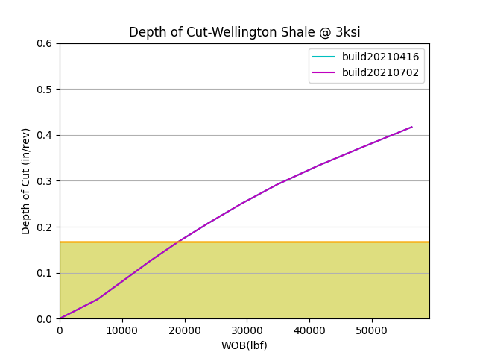

Slide 224
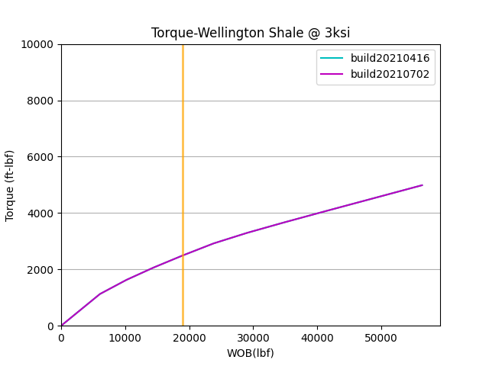

Slide 225
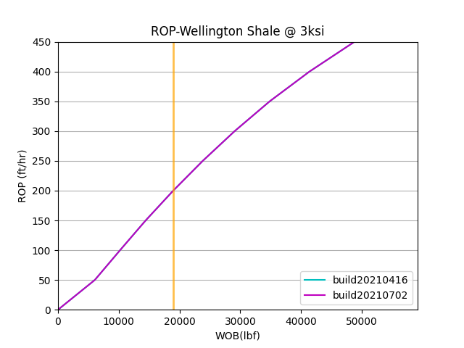

Slide 226
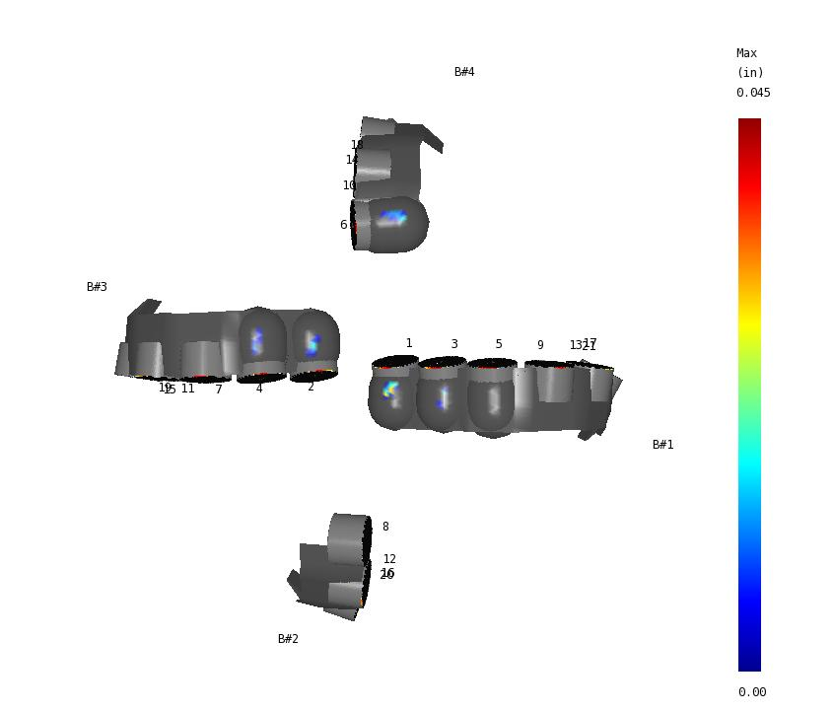
Contact Analysis Comparison - Blade Top Contact
ROP Controlled: 50.00 ft/hr
Build20210416
Build20210702

Slide 227

Contact Analysis Comparison - Blade Top Contact
ROP Controlled: 100.00 ft/hr
Build20210416
Build20210702

Slide 228

Contact Analysis Comparison - Blade Top Contact
ROP Controlled: 150.00 ft/hr
Build20210416
Build20210702

Slide 229

Contact Analysis Comparison - Blade Top Contact
ROP Controlled: 200.00 ft/hr
Build20210416
Build20210702

Slide 230

Contact Analysis Comparison - Blade Top Contact
ROP Controlled: 250.00 ft/hr
Build20210416
Build20210702

Slide 231

Contact Analysis Comparison - Blade Top Contact
ROP Controlled: 300.00 ft/hr
Build20210416
Build20210702

Slide 232
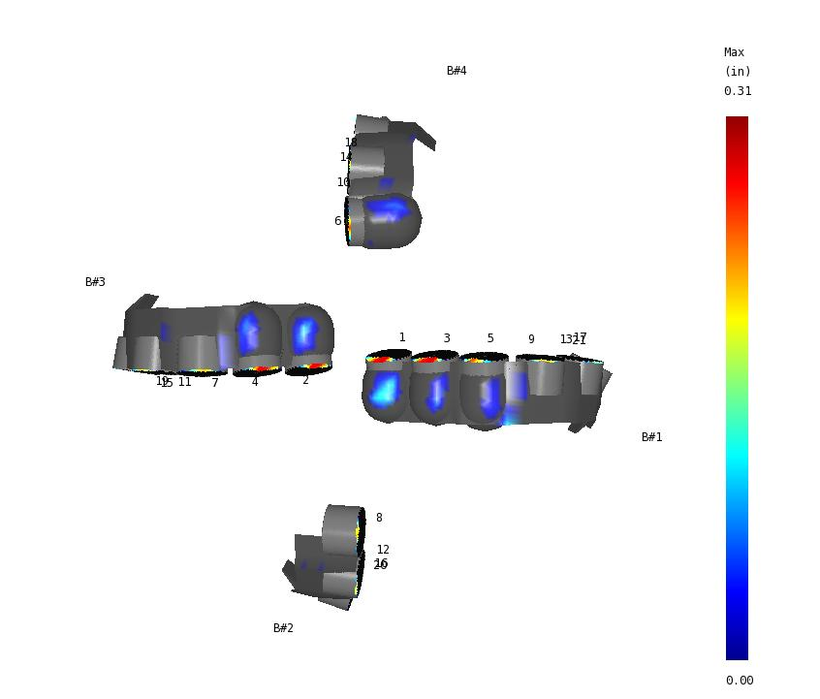
Contact Analysis Comparison - Blade Top Contact
ROP Controlled: 350.00 ft/hr
Build20210416
Build20210702

Slide 233

Contact Analysis Comparison - Blade Top Contact
ROP Controlled: 400.00 ft/hr
Build20210416
Build20210702

Slide 234
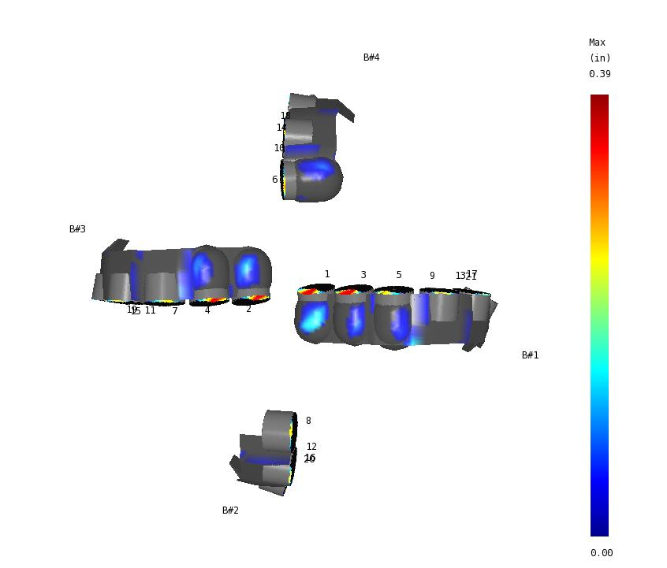
Contact Analysis Comparison - Blade Top Contact
ROP Controlled: 450.00 ft/hr
Build20210416
Build20210702

Slide 235

Contact Analysis Comparison - Blade Top Contact
ROP Controlled: 500.00 ft/hr
Build20210416
Build20210702

Slide 236
Dynamic Analysis Results

Slide 237
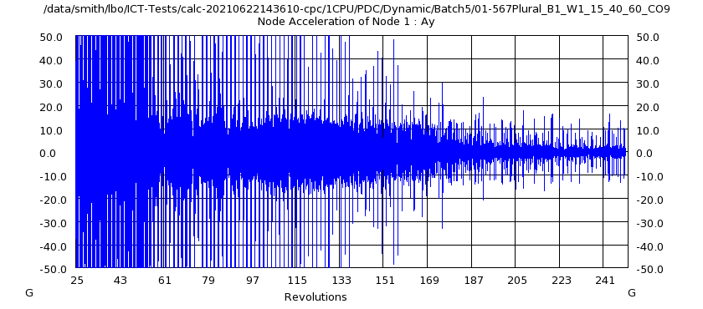
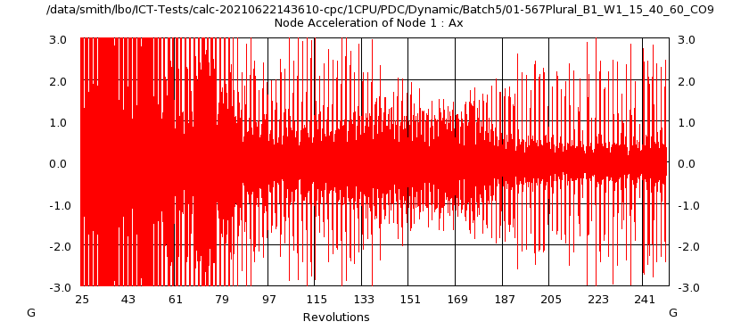
Dynamic Results
Created Using Multi-Bit Compare RevE & Template: SAM_temp_2021-07-28_14.52.48.pptx
Well: 12,000 ft @ 0.0?inc; BHA: Steerable Motor @ 1.5?Bend
Sandstone (5-10 ksi) - Colton; WOB: 15K lb; RPM: 40(R) + 60(M)
CR: Convergence Ratio
Lateral Acceleration
Axial Acceleration
new_567_plural
CR=82.89
ROP=34.1
Tq=2330.9
SS%=16.33
new_567_plural
CR=82.89
ROP=34.1 (0.0%Δ)
Tq=2330.9 (0.0%Δ)
SS%=16.33

Slide 238
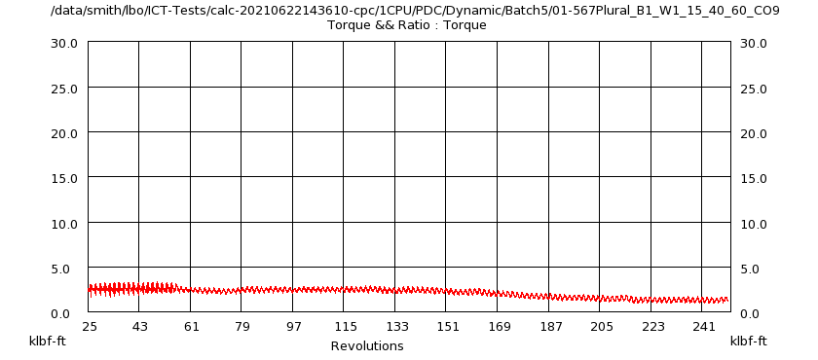
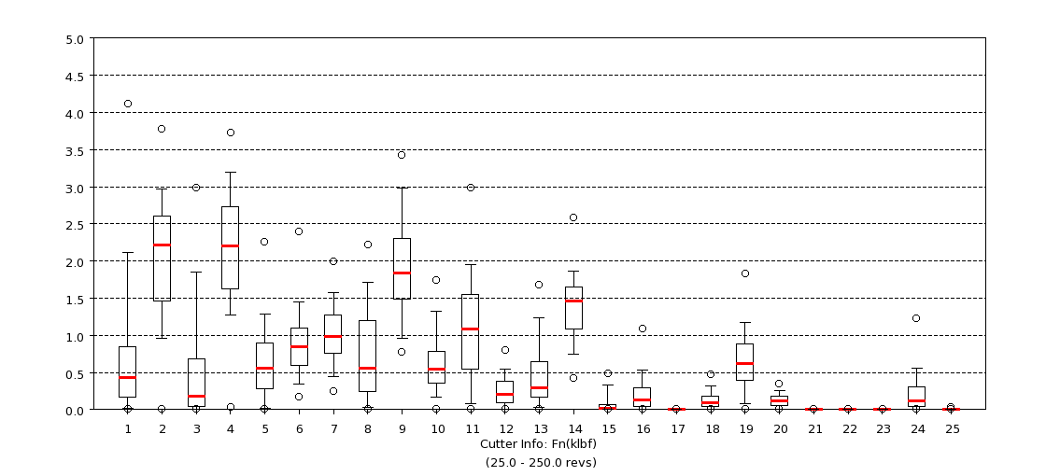
Dynamic Results
Created Using Multi-Bit Compare RevE & Template: SAM_temp_2021-07-28_14.52.48.pptx
Well: 12,000 ft @ 0.0?inc; BHA: Steerable Motor @ 1.5?Bend
Sandstone (5-10 ksi) - Colton; WOB: 15K lb; RPM: 40(R) + 60(M)
CR: Convergence Ratio
Bit Torque
Cutter Normal Force
new_567_plural
CR=82.89
ROP=34.1
Tq=2330.9
SS%=16.33
new_567_plural
CR=82.89
ROP=34.1 (0.0%Δ)
Tq=2330.9 (0.0%Δ)
SS%=16.33

Slide 239
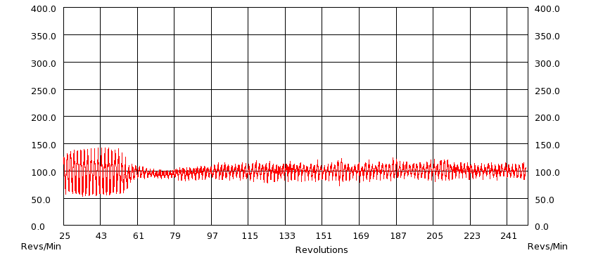
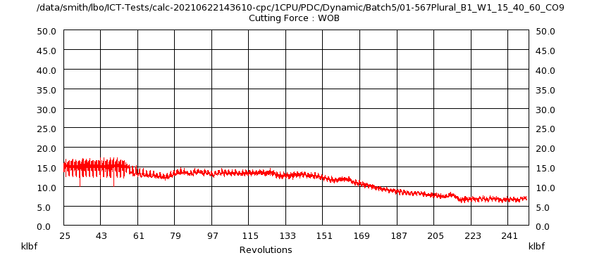
Dynamic Results
Created Using Multi-Bit Compare RevE & Template: SAM_temp_2021-07-28_14.52.48.pptx
Well: 12,000 ft @ 0.0?inc; BHA: Steerable Motor @ 1.5?Bend
Sandstone (5-10 ksi) - Colton; WOB: 15K lb; RPM: 40(R) + 60(M)
CR: Convergence Ratio
RPM
WOB
new_567_plural
CR=82.89
ROP=34.1
Tq=2330.9
SS%=16.33
new_567_plural
CR=82.89
ROP=34.1 (0.0%Δ)
Tq=2330.9 (0.0%Δ)
SS%=16.33

Slide 240
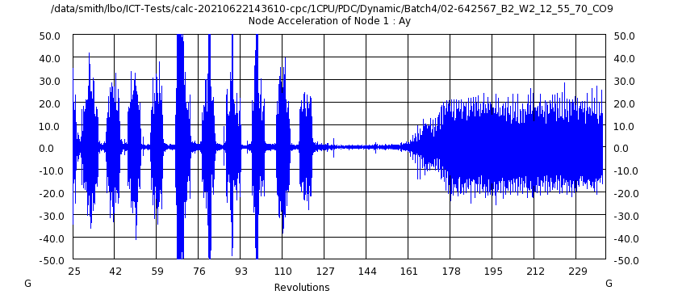
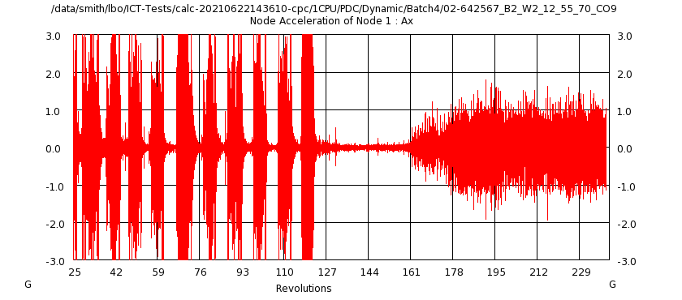
Dynamic Results
Created Using Multi-Bit Compare RevE & Template: SAM_temp_2021-07-28_14.52.48.pptx
Well: 10,000 ft @ 0.0?inc; BHA: StraightHole Motor
Sandstone (5-10 ksi) - Colton; WOB: 12K lb; RPM: 55(R) + 70(M)
CR: Convergence Ratio
Lateral Acceleration
Axial Acceleration
new_567_plural
CR=93.37
ROP=30.0
Tq=1444.5
SS%=40.66
new_567_plural
CR=93.37
ROP=30.0 (0.0%Δ)
Tq=1444.5 (0.0%Δ)
SS%=40.66

Slide 241
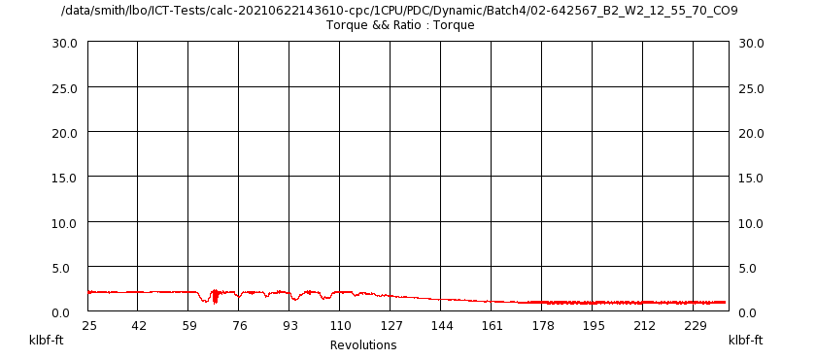
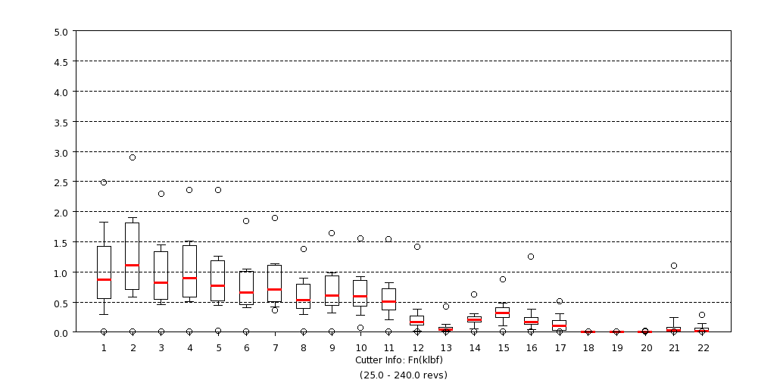
Dynamic Results
Created Using Multi-Bit Compare RevE & Template: SAM_temp_2021-07-28_14.52.48.pptx
Well: 10,000 ft @ 0.0?inc; BHA: StraightHole Motor
Sandstone (5-10 ksi) - Colton; WOB: 12K lb; RPM: 55(R) + 70(M)
CR: Convergence Ratio
Bit Torque
Cutter Normal Force
new_567_plural
CR=93.37
ROP=30.0
Tq=1444.5
SS%=40.66
new_567_plural
CR=93.37
ROP=30.0 (0.0%Δ)
Tq=1444.5 (0.0%Δ)
SS%=40.66

Slide 242
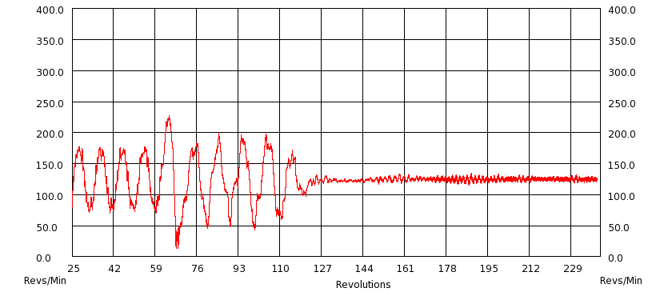
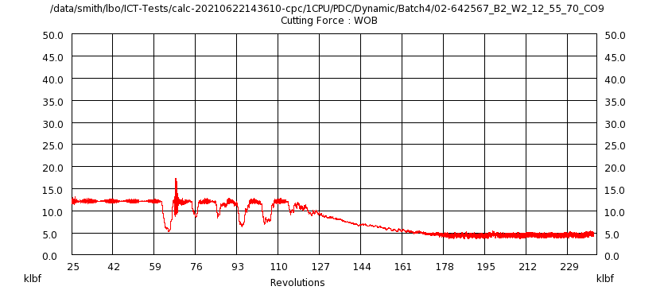
Dynamic Results
Created Using Multi-Bit Compare RevE & Template: SAM_temp_2021-07-28_14.52.48.pptx
Well: 10,000 ft @ 0.0?inc; BHA: StraightHole Motor
Sandstone (5-10 ksi) - Colton; WOB: 12K lb; RPM: 55(R) + 70(M)
CR: Convergence Ratio
RPM
WOB
new_567_plural
CR=93.37
ROP=30.0
Tq=1444.5
SS%=40.66
new_567_plural
CR=93.37
ROP=30.0 (0.0%Δ)
Tq=1444.5 (0.0%Δ)
SS%=40.66

Slide 243
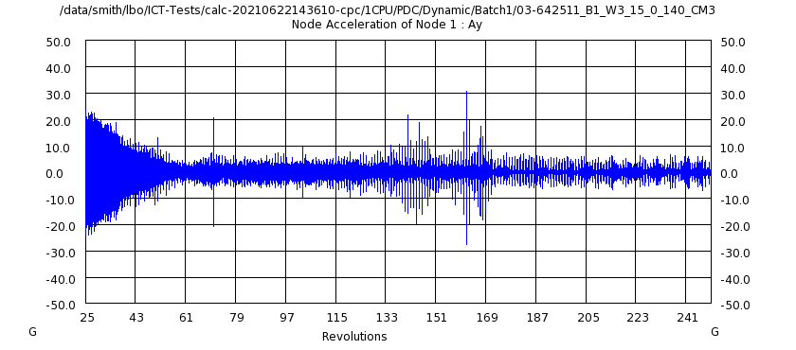
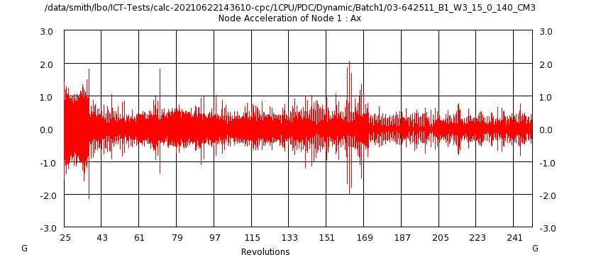
Dynamic Results
Created Using Multi-Bit Compare RevE & Template: SAM_temp_2021-07-28_14.52.48.pptx
Well: 2,462 ft @ 2.5?inc; BHA: Steerable Motor @ 1.83?Bend
Carbonate (10-15 ksi) - Carthage Marble; WOB: 15K lb; RPM: 0(R) + 140(M)
CR: Convergence Ratio
Lateral Acceleration
Axial Acceleration
new_567_plural
CR=96.84
ROP=43.3
Tq=3233.5
SS%=2.79
new_567_plural
CR=96.84
ROP=43.3 (0.0%Δ)
Tq=3233.5 (0.0%Δ)
SS%=2.79

Slide 244
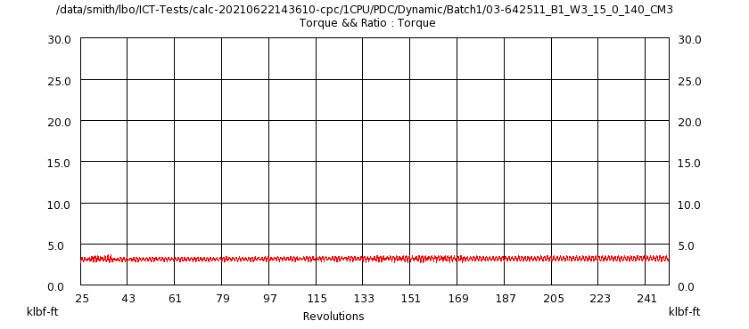
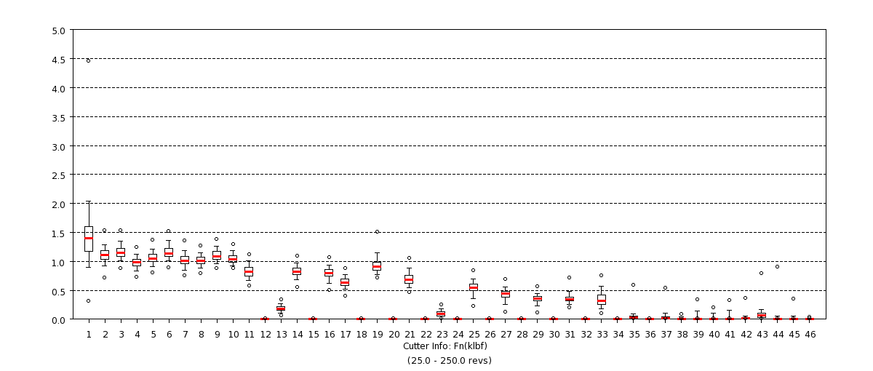
Dynamic Results
Created Using Multi-Bit Compare RevE & Template: SAM_temp_2021-07-28_14.52.48.pptx
Well: 2,462 ft @ 2.5?inc; BHA: Steerable Motor @ 1.83?Bend
Carbonate (10-15 ksi) - Carthage Marble; WOB: 15K lb; RPM: 0(R) + 140(M)
CR: Convergence Ratio
Bit Torque
Cutter Normal Force
new_567_plural
CR=96.84
ROP=43.3
Tq=3233.5
SS%=2.79
new_567_plural
CR=96.84
ROP=43.3 (0.0%Δ)
Tq=3233.5 (0.0%Δ)
SS%=2.79

Slide 245
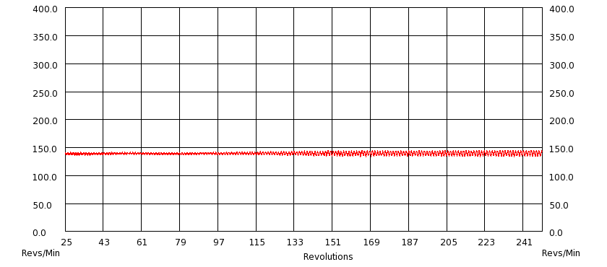
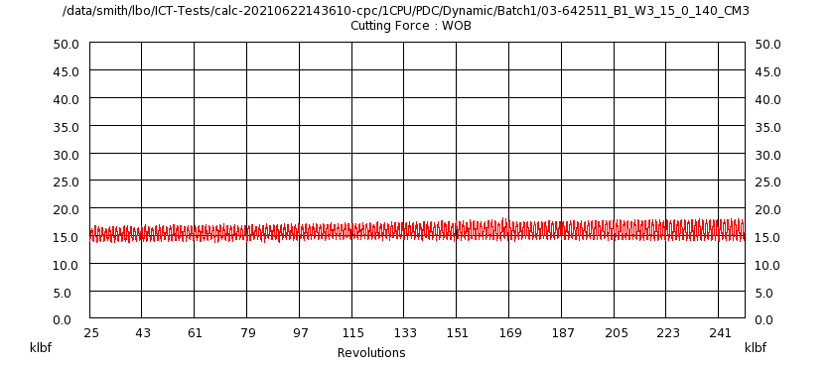
Dynamic Results
Created Using Multi-Bit Compare RevE & Template: SAM_temp_2021-07-28_14.52.48.pptx
Well: 2,462 ft @ 2.5?inc; BHA: Steerable Motor @ 1.83?Bend
Carbonate (10-15 ksi) - Carthage Marble; WOB: 15K lb; RPM: 0(R) + 140(M)
CR: Convergence Ratio
RPM
WOB
new_567_plural
CR=96.84
ROP=43.3
Tq=3233.5
SS%=2.79
new_567_plural
CR=96.84
ROP=43.3 (0.0%Δ)
Tq=3233.5 (0.0%Δ)
SS%=2.79

Slide 246
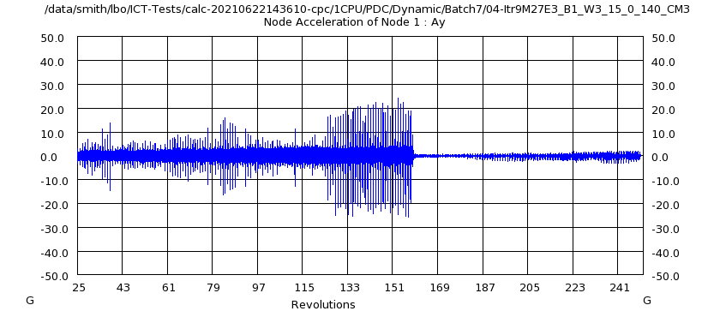
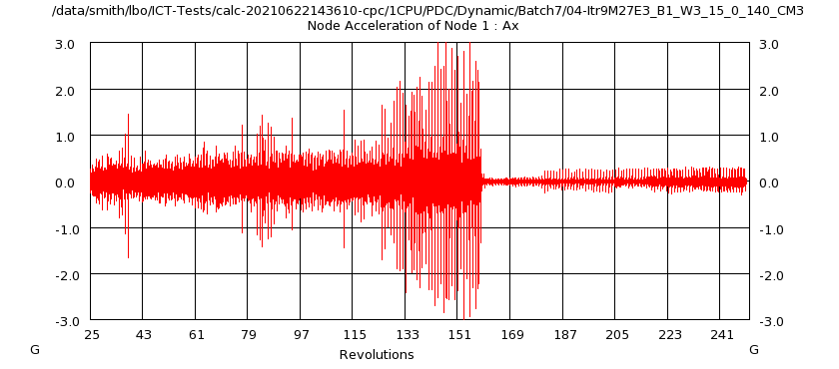
Dynamic Results
Created Using Multi-Bit Compare RevE & Template: SAM_temp_2021-07-28_14.52.48.pptx
Well: 2,462 ft @ 2.5?inc; BHA: Steerable Motor @ 1.83?Bend
Carbonate (10-15 ksi) - Carthage Marble; WOB: 15K lb; RPM: 0(R) + 140(M)
CR: Convergence Ratio
Lateral Acceleration
Axial Acceleration
new_567_plural
CR=99.23
ROP=47.0
Tq=3633.8
SS%=0.54
new_567_plural
CR=99.23
ROP=47.0 (0.0%Δ)
Tq=3633.8 (0.0%Δ)
SS%=0.54

Slide 247
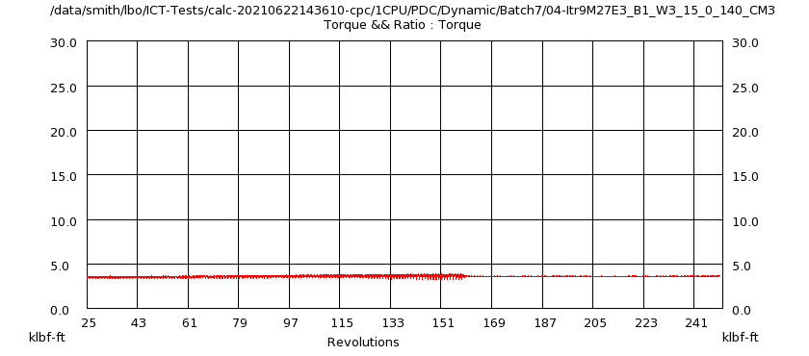
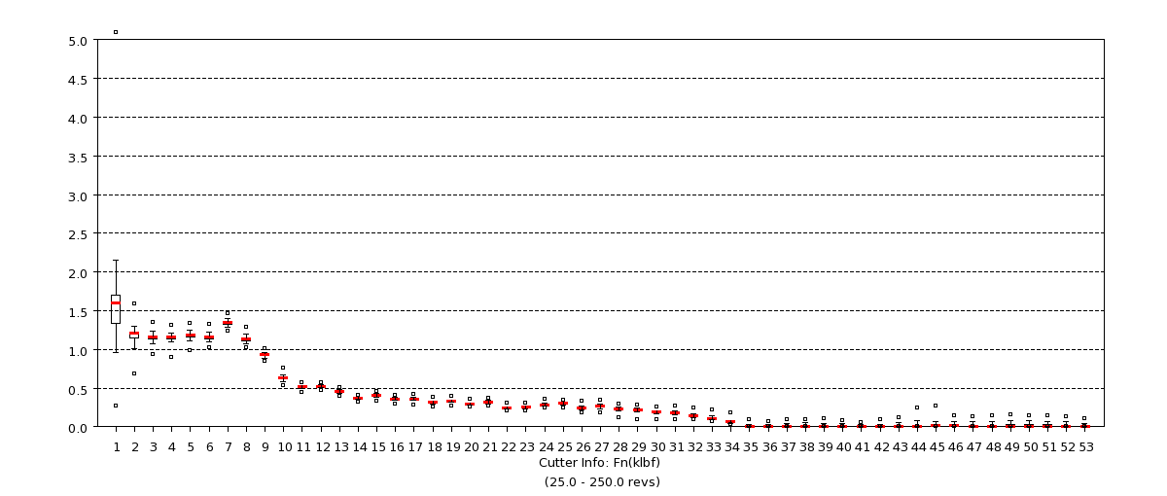
Dynamic Results
Created Using Multi-Bit Compare RevE & Template: SAM_temp_2021-07-28_14.52.48.pptx
Well: 2,462 ft @ 2.5?inc; BHA: Steerable Motor @ 1.83?Bend
Carbonate (10-15 ksi) - Carthage Marble; WOB: 15K lb; RPM: 0(R) + 140(M)
CR: Convergence Ratio
Bit Torque
Cutter Normal Force
new_567_plural
CR=99.23
ROP=47.0
Tq=3633.8
SS%=0.54
new_567_plural
CR=99.23
ROP=47.0 (0.0%Δ)
Tq=3633.8 (0.0%Δ)
SS%=0.54

Slide 248
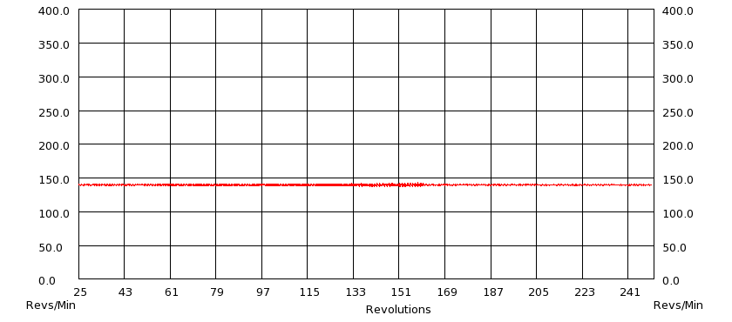
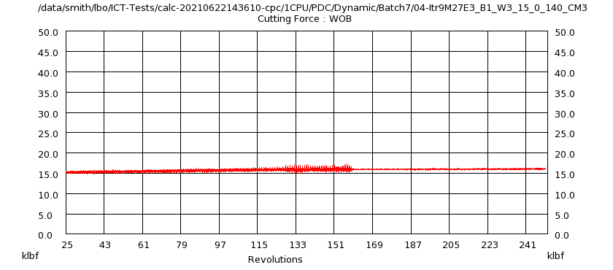
Dynamic Results
Created Using Multi-Bit Compare RevE & Template: SAM_temp_2021-07-28_14.52.48.pptx
Well: 2,462 ft @ 2.5?inc; BHA: Steerable Motor @ 1.83?Bend
Carbonate (10-15 ksi) - Carthage Marble; WOB: 15K lb; RPM: 0(R) + 140(M)
CR: Convergence Ratio
RPM
WOB
new_567_plural
CR=99.23
ROP=47.0
Tq=3633.8
SS%=0.54
new_567_plural
CR=99.23
ROP=47.0 (0.0%Δ)
Tq=3633.8 (0.0%Δ)
SS%=0.54

Slide 249
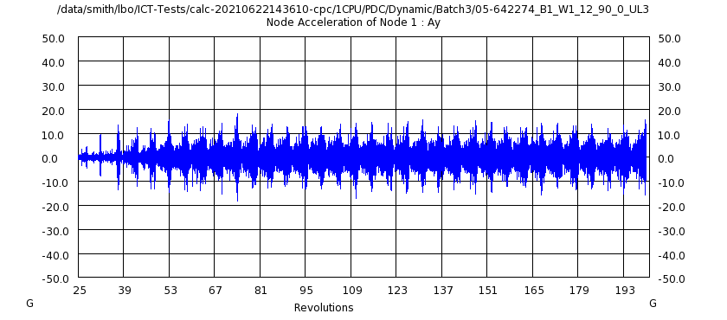
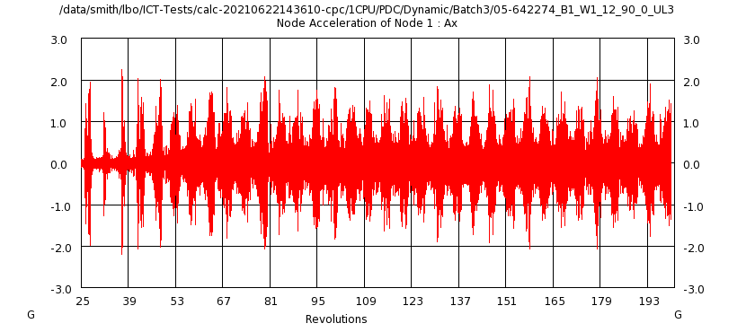
Dynamic Results
Created Using Multi-Bit Compare RevE & Template: SAM_temp_2021-07-28_14.52.48.pptx
Well: 6,000 ft @ 0.0?inc; BHA: Rotary
Carbonate (15-25 ksi) - Utah Lake Limestone; WOB: 12K lb; RPM: 90(R) + 0(M)
CR: Convergence Ratio
Lateral Acceleration
Axial Acceleration
new_567_plural
CR=99.10
ROP=7.0
Tq=1697.6
SS%=57.67
new_567_plural
CR=99.10
ROP=7.0 (0.0%Δ)
Tq=1697.6 (0.0%Δ)
SS%=57.67

Slide 250
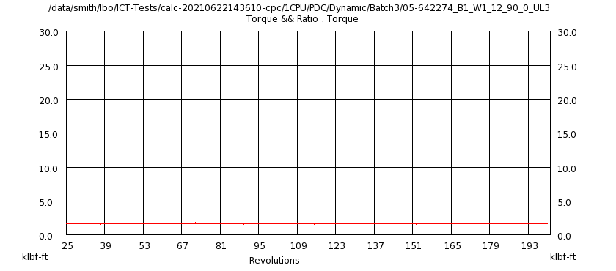
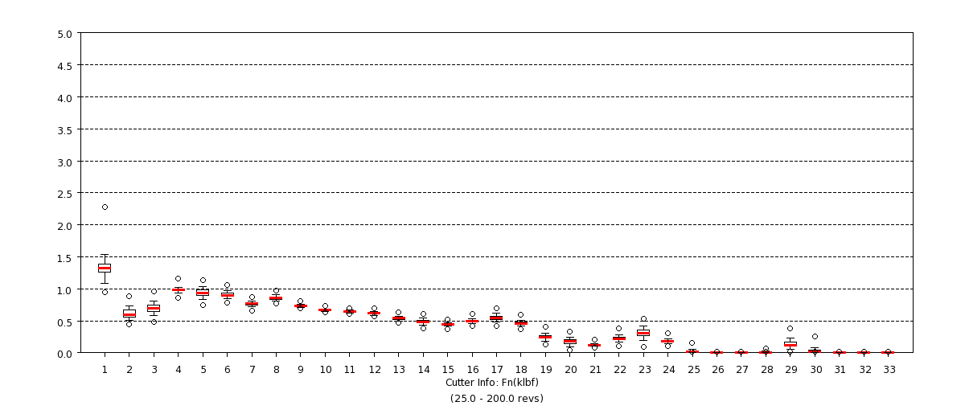
Dynamic Results
Created Using Multi-Bit Compare RevE & Template: SAM_temp_2021-07-28_14.52.48.pptx
Well: 6,000 ft @ 0.0?inc; BHA: Rotary
Carbonate (15-25 ksi) - Utah Lake Limestone; WOB: 12K lb; RPM: 90(R) + 0(M)
CR: Convergence Ratio
Bit Torque
Cutter Normal Force
new_567_plural
CR=99.10
ROP=7.0
Tq=1697.6
SS%=57.67
new_567_plural
CR=99.10
ROP=7.0 (0.0%Δ)
Tq=1697.6 (0.0%Δ)
SS%=57.67

Slide 251
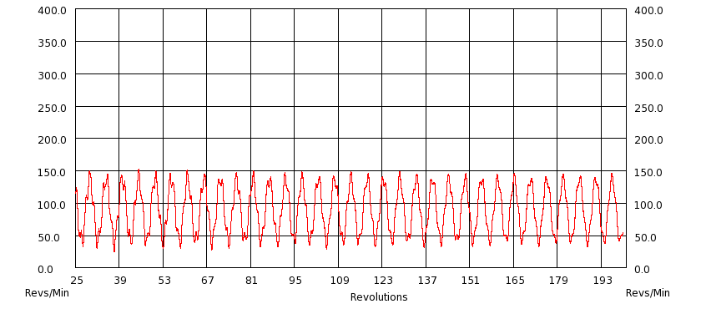
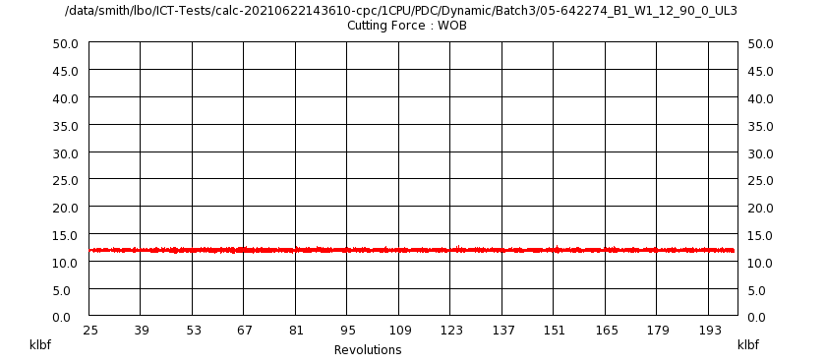
Dynamic Results
Created Using Multi-Bit Compare RevE & Template: SAM_temp_2021-07-28_14.52.48.pptx
Well: 6,000 ft @ 0.0?inc; BHA: Rotary
Carbonate (15-25 ksi) - Utah Lake Limestone; WOB: 12K lb; RPM: 90(R) + 0(M)
CR: Convergence Ratio
RPM
WOB
new_567_plural
CR=99.10
ROP=7.0
Tq=1697.6
SS%=57.67
new_567_plural
CR=99.10
ROP=7.0 (0.0%Δ)
Tq=1697.6 (0.0%Δ)
SS%=57.67

Slide 252
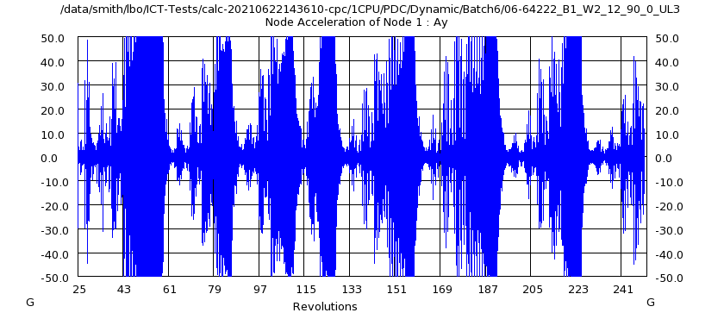
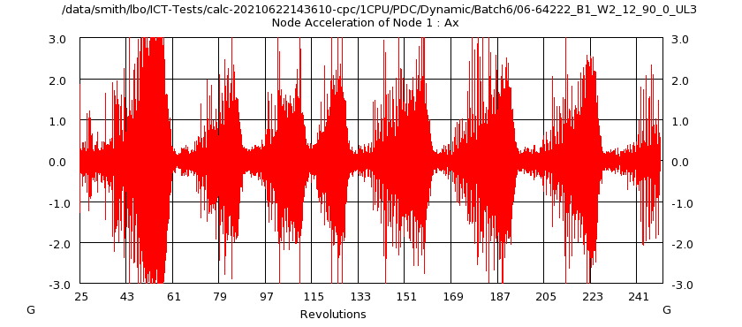
Dynamic Results
Created Using Multi-Bit Compare RevE & Template: SAM_temp_2021-07-28_14.52.48.pptx
Well: 6,004 ft @ 0.0?inc; BHA: Rotary
Carbonate (15-25 ksi) - Utah Lake Limestone; WOB: 12K lb; RPM: 90(R) + 0(M)
CR: Convergence Ratio
Lateral Acceleration
Axial Acceleration
new_567_plural
CR=100.00
ROP=7.6
Tq=1903.1
SS%=33.19
new_567_plural
CR=100.00
ROP=7.6 (0.0%Δ)
Tq=1903.1 (0.0%Δ)
SS%=33.19

Slide 253
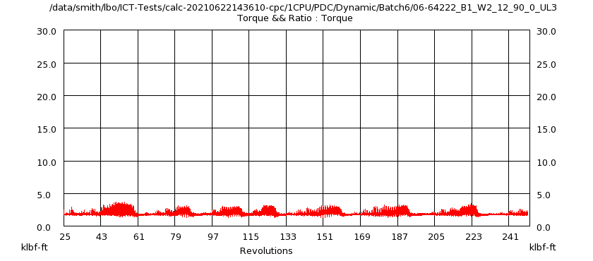
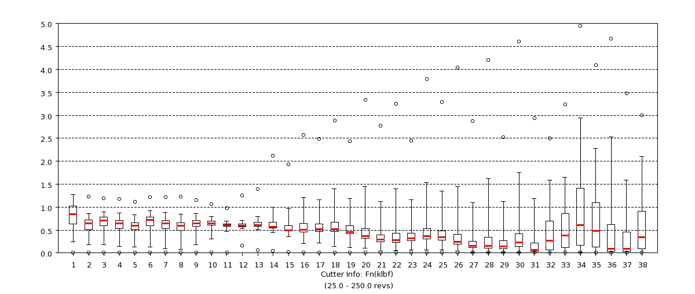
Dynamic Results
Created Using Multi-Bit Compare RevE & Template: SAM_temp_2021-07-28_14.52.48.pptx
Well: 6,004 ft @ 0.0?inc; BHA: Rotary
Carbonate (15-25 ksi) - Utah Lake Limestone; WOB: 12K lb; RPM: 90(R) + 0(M)
CR: Convergence Ratio
Bit Torque
Cutter Normal Force
new_567_plural
CR=100.00
ROP=7.6
Tq=1903.1
SS%=33.19
new_567_plural
CR=100.00
ROP=7.6 (0.0%Δ)
Tq=1903.1 (0.0%Δ)
SS%=33.19

Slide 254
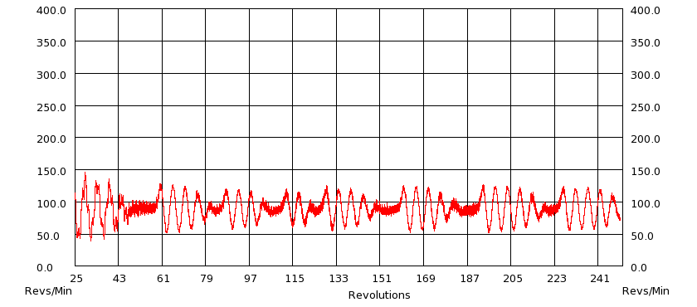
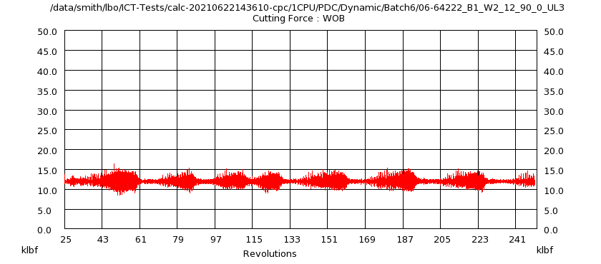
Dynamic Results
Created Using Multi-Bit Compare RevE & Template: SAM_temp_2021-07-28_14.52.48.pptx
Well: 6,004 ft @ 0.0?inc; BHA: Rotary
Carbonate (15-25 ksi) - Utah Lake Limestone; WOB: 12K lb; RPM: 90(R) + 0(M)
CR: Convergence Ratio
RPM
WOB
new_567_plural
CR=100.00
ROP=7.6
Tq=1903.1
SS%=33.19
new_567_plural
CR=100.00
ROP=7.6 (0.0%Δ)
Tq=1903.1 (0.0%Δ)
SS%=33.19

Slide 255
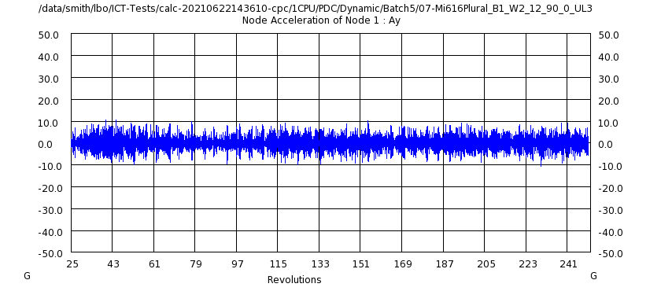
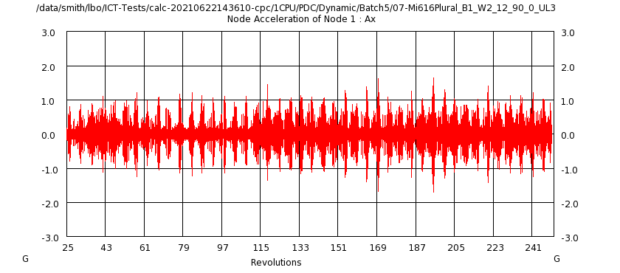
Dynamic Results
Created Using Multi-Bit Compare RevE & Template: SAM_temp_2021-07-28_14.52.48.pptx
Well: 6,004 ft @ 0.0?inc; BHA: Rotary
Carbonate (15-25 ksi) - Utah Lake Limestone; WOB: 12K lb; RPM: 90(R) + 0(M)
CR: Convergence Ratio
Lateral Acceleration
Axial Acceleration
new_567_plural
CR=100.00
ROP=6.6
Tq=1812.8
SS%=53.59
new_567_plural
CR=100.00
ROP=6.6 (0.0%Δ)
Tq=1812.8 (0.0%Δ)
SS%=53.59

Slide 256
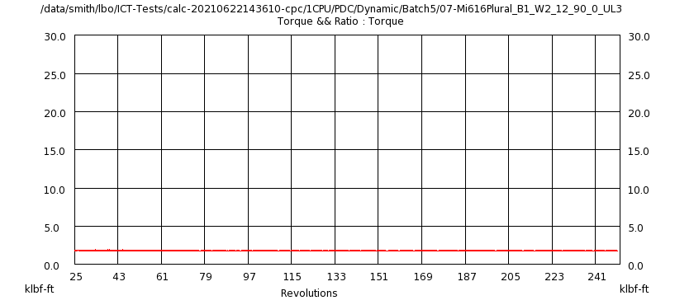
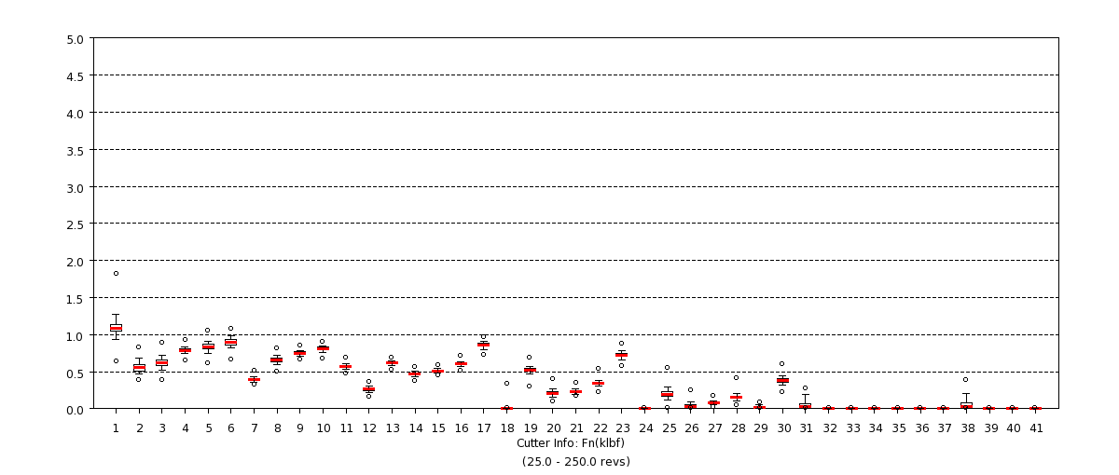
Dynamic Results
Created Using Multi-Bit Compare RevE & Template: SAM_temp_2021-07-28_14.52.48.pptx
Well: 6,004 ft @ 0.0?inc; BHA: Rotary
Carbonate (15-25 ksi) - Utah Lake Limestone; WOB: 12K lb; RPM: 90(R) + 0(M)
CR: Convergence Ratio
Bit Torque
Cutter Normal Force
new_567_plural
CR=100.00
ROP=6.6
Tq=1812.8
SS%=53.59
new_567_plural
CR=100.00
ROP=6.6 (0.0%Δ)
Tq=1812.8 (0.0%Δ)
SS%=53.59

Slide 257
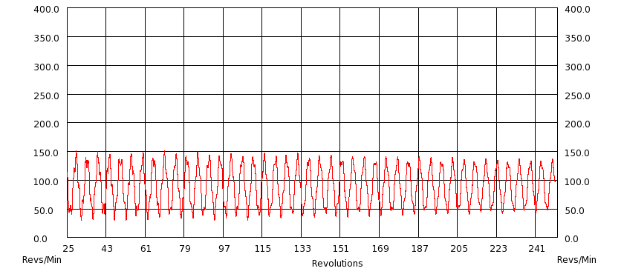
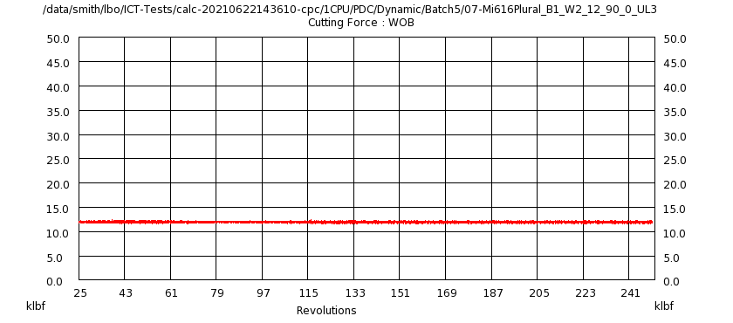
Dynamic Results
Created Using Multi-Bit Compare RevE & Template: SAM_temp_2021-07-28_14.52.48.pptx
Well: 6,004 ft @ 0.0?inc; BHA: Rotary
Carbonate (15-25 ksi) - Utah Lake Limestone; WOB: 12K lb; RPM: 90(R) + 0(M)
CR: Convergence Ratio
RPM
WOB
new_567_plural
CR=100.00
ROP=6.6
Tq=1812.8
SS%=53.59
new_567_plural
CR=100.00
ROP=6.6 (0.0%Δ)
Tq=1812.8 (0.0%Δ)
SS%=53.59

Slide 258
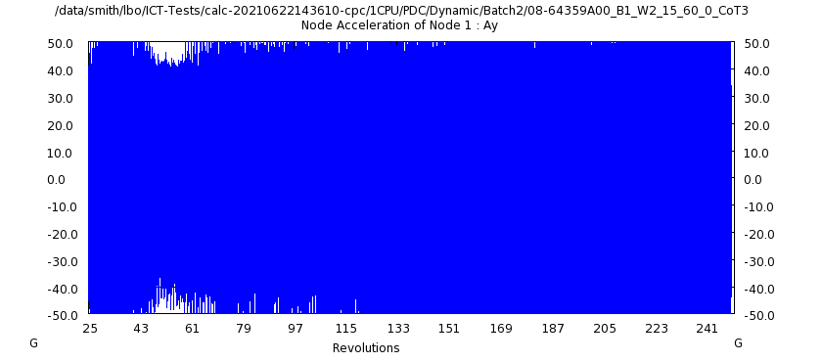
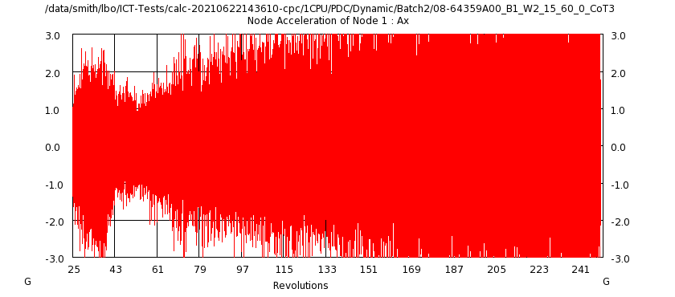
Dynamic Results
Created Using Multi-Bit Compare RevE & Template: SAM_temp_2021-07-28_14.52.48.pptx
Well: 9,500 ft @ 0.0?inc; BHA: Rotary
Sandstone (20-30 ksi) - Colorado Tan; WOB: 15K lb; RPM: 60(R) + 0(M)
CR: Convergence Ratio
Lateral Acceleration
Axial Acceleration
new_567_plural
CR=95.54
ROP=4.0
Tq=3016.6
SS%=10.93
new_567_plural
CR=95.54
ROP=4.0 (0.0%Δ)
Tq=3016.6 (0.0%Δ)
SS%=10.93

Slide 259


Dynamic Results
Created Using Multi-Bit Compare RevE & Template: SAM_temp_2021-07-28_14.52.48.pptx
Well: 9,500 ft @ 0.0?inc; BHA: Rotary
Sandstone (20-30 ksi) - Colorado Tan; WOB: 15K lb; RPM: 60(R) + 0(M)
CR: Convergence Ratio
Bit Torque
Cutter Normal Force
new_567_plural
CR=95.54
ROP=4.0
Tq=3016.6
SS%=10.93
new_567_plural
CR=95.54
ROP=4.0 (0.0%Δ)
Tq=3016.6 (0.0%Δ)
SS%=10.93

Slide 260


Dynamic Results
Created Using Multi-Bit Compare RevE & Template: SAM_temp_2021-07-28_14.52.48.pptx
Well: 9,500 ft @ 0.0?inc; BHA: Rotary
Sandstone (20-30 ksi) - Colorado Tan; WOB: 15K lb; RPM: 60(R) + 0(M)
CR: Convergence Ratio
RPM
WOB
new_567_plural
CR=95.54
ROP=4.0
Tq=3016.6
SS%=10.93
new_567_plural
CR=95.54
ROP=4.0 (0.0%Δ)
Tq=3016.6 (0.0%Δ)
SS%=10.93

Slide 261


Dynamic Results
Created Using Multi-Bit Compare RevE & Template: SAM_temp_2021-07-28_14.52.48.pptx
Well: 9,500 ft @ 0.0?inc; BHA: Rotary
Sandstone (20-30 ksi) - Colorado Tan; WOB: 15K lb; RPM: 60(R) + 0(M)
CR: Convergence Ratio
Lateral Acceleration
Axial Acceleration
new_567_plural
CR=99.46
ROP=4.5
Tq=3220.9
SS%=78.22
new_567_plural
CR=99.46
ROP=4.5 (0.0%Δ)
Tq=3220.9 (0.0%Δ)
SS%=78.22

Slide 262


Dynamic Results
Created Using Multi-Bit Compare RevE & Template: SAM_temp_2021-07-28_14.52.48.pptx
Well: 9,500 ft @ 0.0?inc; BHA: Rotary
Sandstone (20-30 ksi) - Colorado Tan; WOB: 15K lb; RPM: 60(R) + 0(M)
CR: Convergence Ratio
Bit Torque
Cutter Normal Force
new_567_plural
CR=99.46
ROP=4.5
Tq=3220.9
SS%=78.22
new_567_plural
CR=99.46
ROP=4.5 (0.0%Δ)
Tq=3220.9 (0.0%Δ)
SS%=78.22

Slide 263


Dynamic Results
Created Using Multi-Bit Compare RevE & Template: SAM_temp_2021-07-28_14.52.48.pptx
Well: 9,500 ft @ 0.0?inc; BHA: Rotary
Sandstone (20-30 ksi) - Colorado Tan; WOB: 15K lb; RPM: 60(R) + 0(M)
CR: Convergence Ratio
RPM
WOB
new_567_plural
CR=99.46
ROP=4.5
Tq=3220.9
SS%=78.22
new_567_plural
CR=99.46
ROP=4.5 (0.0%Δ)
Tq=3220.9 (0.0%Δ)
SS%=78.22

Slide 264


Dynamic Results
Created Using Multi-Bit Compare RevE & Template: SAM_temp_2021-07-28_14.52.48.pptx
Well: 6,000 ft @ 0.0?inc; BHA: StraightHole Motor
Carbonate (10-15 ksi) - Carthage Marble; WOB: 28K lb; RPM: 65(R) + 80(M)
CR: Convergence Ratio
Lateral Acceleration
Axial Acceleration
new_567_plural
CR=99.06
ROP=49.5
Tq=10167.8
SS%=6.32
new_567_plural
CR=99.06
ROP=49.5 (0.0%Δ)
Tq=10167.8 (0.0%Δ)
SS%=6.32

Slide 265


Dynamic Results
Created Using Multi-Bit Compare RevE & Template: SAM_temp_2021-07-28_14.52.48.pptx
Well: 6,000 ft @ 0.0?inc; BHA: StraightHole Motor
Carbonate (10-15 ksi) - Carthage Marble; WOB: 28K lb; RPM: 65(R) + 80(M)
CR: Convergence Ratio
Bit Torque
Cutter Normal Force
new_567_plural
CR=99.06
ROP=49.5
Tq=10167.8
SS%=6.32
new_567_plural
CR=99.06
ROP=49.5 (0.0%Δ)
Tq=10167.8 (0.0%Δ)
SS%=6.32

Slide 266


Dynamic Results
Created Using Multi-Bit Compare RevE & Template: SAM_temp_2021-07-28_14.52.48.pptx
Well: 6,000 ft @ 0.0?inc; BHA: StraightHole Motor
Carbonate (10-15 ksi) - Carthage Marble; WOB: 28K lb; RPM: 65(R) + 80(M)
CR: Convergence Ratio
RPM
WOB
new_567_plural
CR=99.06
ROP=49.5
Tq=10167.8
SS%=6.32
new_567_plural
CR=99.06
ROP=49.5 (0.0%Δ)
Tq=10167.8 (0.0%Δ)
SS%=6.32

Slide 267


Dynamic Results
Created Using Multi-Bit Compare RevE & Template: SAM_temp_2021-07-28_14.52.48.pptx
Well: 6,000 ft @ 0.0?inc; BHA: StraightHole Motor
Carbonate (10-15 ksi) - Carthage Marble; WOB: 28K lb; RPM: 65(R) + 80(M)
CR: Convergence Ratio
Lateral Acceleration
Axial Acceleration
new_567_plural
CR=99.03
ROP=53.7
Tq=9430.3
SS%=75.52
new_567_plural
CR=99.03
ROP=53.7 (0.0%Δ)
Tq=9430.3 (0.0%Δ)
SS%=75.52

Slide 268


Dynamic Results
Created Using Multi-Bit Compare RevE & Template: SAM_temp_2021-07-28_14.52.48.pptx
Well: 6,000 ft @ 0.0?inc; BHA: StraightHole Motor
Carbonate (10-15 ksi) - Carthage Marble; WOB: 28K lb; RPM: 65(R) + 80(M)
CR: Convergence Ratio
Bit Torque
Cutter Normal Force
new_567_plural
CR=99.03
ROP=53.7
Tq=9430.3
SS%=75.52
new_567_plural
CR=99.03
ROP=53.7 (0.0%Δ)
Tq=9430.3 (0.0%Δ)
SS%=75.52

Slide 269


Dynamic Results
Created Using Multi-Bit Compare RevE & Template: SAM_temp_2021-07-28_14.52.48.pptx
Well: 6,000 ft @ 0.0?inc; BHA: StraightHole Motor
Carbonate (10-15 ksi) - Carthage Marble; WOB: 28K lb; RPM: 65(R) + 80(M)
CR: Convergence Ratio
RPM
WOB
new_567_plural
CR=99.03
ROP=53.7
Tq=9430.3
SS%=75.52
new_567_plural
CR=99.03
ROP=53.7 (0.0%Δ)
Tq=9430.3 (0.0%Δ)
SS%=75.52

Slide 270


Dynamic Results
Created Using Multi-Bit Compare RevE & Template: SAM_temp_2021-07-28_14.52.48.pptx
Well: 7,300 ft @ 0.0?inc; BHA: StraightHole Motor
JB Limestone; WOB: 50K lb; RPM: 120(R) + 150(M)
CR: Convergence Ratio
Lateral Acceleration
Axial Acceleration
new_567_plural
CR=98.98
ROP=72.7
Tq=19139.6
SS%=65.73
new_567_plural
CR=98.98
ROP=72.7 (0.0%Δ)
Tq=19139.6 (0.0%Δ)
SS%=65.73

Slide 271


Dynamic Results
Created Using Multi-Bit Compare RevE & Template: SAM_temp_2021-07-28_14.52.48.pptx
Well: 7,300 ft @ 0.0?inc; BHA: StraightHole Motor
JB Limestone; WOB: 50K lb; RPM: 120(R) + 150(M)
CR: Convergence Ratio
Bit Torque
Cutter Normal Force
new_567_plural
CR=98.98
ROP=72.7
Tq=19139.6
SS%=65.73
new_567_plural
CR=98.98
ROP=72.7 (0.0%Δ)
Tq=19139.6 (0.0%Δ)
SS%=65.73

Slide 272


Dynamic Results
Created Using Multi-Bit Compare RevE & Template: SAM_temp_2021-07-28_14.52.48.pptx
Well: 7,300 ft @ 0.0?inc; BHA: StraightHole Motor
JB Limestone; WOB: 50K lb; RPM: 120(R) + 150(M)
CR: Convergence Ratio
RPM
WOB
new_567_plural
CR=98.98
ROP=72.7
Tq=19139.6
SS%=65.73
new_567_plural
CR=98.98
ROP=72.7 (0.0%Δ)
Tq=19139.6 (0.0%Δ)
SS%=65.73

Slide 273


Dynamic Results
Created Using Multi-Bit Compare RevE & Template: SAM_temp_2021-07-28_14.52.48.pptx
Well: 7,300 ft @ 0.0?inc; BHA: StraightHole Motor
JB Limestone; WOB: 50K lb; RPM: 120(R) + 150(M)
CR: Convergence Ratio
Lateral Acceleration
Axial Acceleration
new_567_plural
CR=98.96
ROP=67.1
Tq=20198.4
SS%=71.10
new_567_plural
CR=98.96
ROP=67.1 (0.0%Δ)
Tq=20198.4 (0.0%Δ)
SS%=71.10

Slide 274


Dynamic Results
Created Using Multi-Bit Compare RevE & Template: SAM_temp_2021-07-28_14.52.48.pptx
Well: 7,300 ft @ 0.0?inc; BHA: StraightHole Motor
JB Limestone; WOB: 50K lb; RPM: 120(R) + 150(M)
CR: Convergence Ratio
Bit Torque
Cutter Normal Force
new_567_plural
CR=98.96
ROP=67.1
Tq=20198.4
SS%=71.10
new_567_plural
CR=98.96
ROP=67.1 (0.0%Δ)
Tq=20198.4 (0.0%Δ)
SS%=71.10

Slide 275


Dynamic Results
Created Using Multi-Bit Compare RevE & Template: SAM_temp_2021-07-28_14.52.48.pptx
Well: 7,300 ft @ 0.0?inc; BHA: StraightHole Motor
JB Limestone; WOB: 50K lb; RPM: 120(R) + 150(M)
CR: Convergence Ratio
RPM
WOB
new_567_plural
CR=98.96
ROP=67.1
Tq=20198.4
SS%=71.10
new_567_plural
CR=98.96
ROP=67.1 (0.0%Δ)
Tq=20198.4 (0.0%Δ)
SS%=71.10

Slide 276
Dynamic ROP

Slide 277
Dynamic Torque

Slide 278
Dynamic Stick-Slip Percentage

Slide 279
CPU Simulation Times

Slide 280
Conclusion

Slide 281
StrataBlade Changes Build Notes 2020.3.0 on Slide 2 1598771

Slide 282
Conclusion

Slide 283

Profile Comparison

Slide 284


Back Rake/Side Rake Information

Slide 285
Profile Comparison

Slide 286
Back Rake/Side Rake Information

Slide 287
Profile Comparison

Slide 288
Back Rake/Side Rake Information

Slide 289
Profile Comparison

Slide 290
Back Rake/Side Rake Information

Slide 291
Profile Comparison

Slide 292
Back Rake/Side Rake Information

Slide 293
Profile Comparison

Slide 294
Back Rake/Side Rake Information

Slide 295
Profile Comparison

Slide 296
Back Rake/Side Rake Information

Slide 297
Profile Comparison

Slide 298
Back Rake/Side Rake Information

Slide 299
Profile Comparison

Slide 300
Back Rake/Side Rake Information

Slide 301
Profile Comparison

Slide 302
Back Rake/Side Rake Information

Slide 303
Profile Comparison

Slide 304
Back Rake/Side Rake Information

Slide 305
Profile Comparison

Slide 306
Back Rake/Side Rake Information

Slide 307
Profile Comparison

Slide 308
Back Rake/Side Rake Information

Slide 309
Profile Comparison

Slide 310
Back Rake/Side Rake Information

Slide 311
Profile Comparison

Slide 312
Back Rake/Side Rake Information

Slide 313



Cutter Information

Slide 314
Profile Comparison

Slide 315
Back Rake/Side Rake Information

Slide 316
Profile Comparison

Slide 317
Back Rake/Side Rake Information

Slide 318
Profile Comparison

Slide 319
Back Rake/Side Rake Information

Slide 320
Profile Comparison

Slide 321
Back Rake/Side Rake Information

Slide 322
Profile Comparison

Slide 323
Back Rake/Side Rake Information

Slide 324
Profile Comparison

Slide 325
Back Rake/Side Rake Information

Slide 326
Profile Comparison

Slide 327
Back Rake/Side Rake Information

Slide 328
Profile Comparison

Slide 329
Back Rake/Side Rake Information

Slide 330

Cutter Information

Slide 331
Profile Comparison

Slide 332
Back Rake/Side Rake Information

Slide 333
Cutter Information

Slide 334
Profile Comparison

Slide 335
Back Rake/Side Rake Information

Slide 336
Profile Comparison

Slide 337
Back Rake/Side Rake Information

Slide 338
Profile Comparison

Slide 339
Back Rake/Side Rake Information

Slide 340
Profile Comparison

Slide 341
Back Rake/Side Rake Information

Slide 342
Cutter Information

Slide 343

Cutter Information

Slide 344
Profile Comparison

Slide 345
Back Rake/Side Rake Information

Slide 346
Cutter Information

Slide 347
Cutter Information

Slide 348
Profile Comparison

Slide 349
Back Rake/Side Rake Information

Slide 350
Cutter Information

Slide 351
Cutter Information

Slide 352
Profile Comparison

Slide 353
Back Rake/Side Rake Information

Slide 354
Profile Comparison

Slide 355
Back Rake/Side Rake Information

Slide 356
Cutter Information

Slide 357
Cutter Information

Slide 358
Profile Comparison

Slide 359
Back Rake/Side Rake Information

Slide 360
Cutter Information

Slide 361
Cutter Information

Slide 362
Profile Comparison

Slide 363
Back Rake/Side Rake Information

Slide 364
Profile Comparison

Slide 365
Back Rake/Side Rake Information

Slide 366
Cutter Information

Slide 367
Cutter Information

Slide 368
Profile Comparison

Slide 369
Back Rake/Side Rake Information

Slide 370
Cutter Information

Slide 371
Cutter Information

Slide 372
Profile Comparison

Slide 373
Back Rake/Side Rake Information

Slide 374
Cutter Information

Slide 375
Cutter Information

Slide 376
Profile Comparison

Slide 377
Back Rake/Side Rake Information

Slide 378
Cutter Information

Slide 379
Cutter Information

Slide 380
Profile Comparison

Slide 381
Back Rake/Side Rake Information

Slide 382
Cutter Information

Slide 383
Cutter Information

Slide 384
Profile Comparison

Slide 385
Back Rake/Side Rake Information

Slide 386
Cutter Information

Slide 387
Cutter Information

Slide 388
Profile Comparison

Slide 389
Back Rake/Side Rake Information

Slide 390
Cutter Information

Slide 391
Cutter Information

Slide 392
Profile Comparison

Slide 393
Back Rake/Side Rake Information

Slide 394
Cutter Information

Slide 395
Cutter Information

Slide 396
Profile Comparison

Slide 397
Back Rake/Side Rake Information

Slide 398
Cutter Information

Slide 399
Cutter Information

Slide 400
Profile Comparison

Slide 401
Back Rake/Side Rake Information

Slide 402
Cutter Information

Slide 403
Cutter Information

Slide 404
Profile Comparison

Slide 405
Back Rake/Side Rake Information

Slide 406
Cutter Information

Slide 407
Cutter Information

Slide 408
Profile Comparison

Slide 409
Back Rake/Side Rake Information

Slide 410
Cutter Information

Slide 411
Cutter Information

Slide 412
Profile Comparison

Slide 413
Back Rake/Side Rake Information

Slide 414
Cutter Information

Slide 415
Cutter Information

Slide 416
Profile Comparison

Slide 417
Back Rake/Side Rake Information

Slide 418
Cutter Information

Slide 419
Cutter Information

Slide 420
Profile Comparison

Slide 421
Back Rake/Side Rake Information

Slide 422
Cutter Information

Slide 423
Cutter Information

Slide 424
Profile Comparison

Slide 425
Back Rake/Side Rake Information

Slide 426
Cutter Information

Slide 427
Cutter Information

Slide 428
Profile Comparison

Slide 429
Back Rake/Side Rake Information

Slide 430
Cutter Information

Slide 431
Cutter Information

Slide 432
Profile Comparison

Slide 433
Back Rake/Side Rake Information

Slide 434
Cutter Information

Slide 435
Cutter Information

Slide 436




Static Analysis Results

Slide 437




Static Analysis Results

Slide 438




Static Analysis Results

Slide 439




Static Analysis Results

Slide 440




Static Analysis Results

Slide 441




Static Analysis Results

Slide 442




Static Analysis Results

Slide 443




Static Analysis Results

Slide 444




Static Analysis Results

Slide 445




Static Analysis Results

Slide 446




Static Analysis Results

Slide 447




Static Analysis Results

Slide 448
Profile Comparison

Slide 449
Back Rake/Side Rake Information

Slide 450
Cutter Information

Slide 451
Cutter Information

Slide 452
Profile Comparison

Slide 453
Back Rake/Side Rake Information

Slide 454
Cutter Information

Slide 455
Cutter Information

Slide 456




Static Analysis Results

Slide 457




Static Analysis Results

Slide 458




Static Analysis Results

Slide 459




Static Analysis Results

Slide 460




Static Analysis Results

Slide 461




Static Analysis Results

Slide 462




Static Analysis Results

Slide 463




Static Analysis Results

Slide 464




Static Analysis Results

Slide 465




Static Analysis Results

Slide 466




Static Analysis Results

Slide 467




Static Analysis Results

Slide 468
Profile Comparison

Slide 469
Back Rake/Side Rake Information

Slide 470
Cutter Information

Slide 471
Cutter Information

Slide 472
Static Analysis Results

Slide 473



Static Analysis Results

Slide 474



Static Analysis Results

Slide 475



Static Analysis Results

Slide 476
Static Analysis Results

Slide 477



Static Analysis Results

Slide 478



Static Analysis Results

Slide 479



Static Analysis Results

Slide 480
Static Analysis Results

Slide 481



Static Analysis Results

Slide 482



Static Analysis Results

Slide 483



Static Analysis Results

Slide 484
Profile Comparison

Slide 485
Back Rake/Side Rake Information

Slide 486
Cutter Information

Slide 487
Cutter Information

Slide 488
Profile Comparison

Slide 489
Back Rake/Side Rake Information

Slide 490
Cutter Information

Slide 491
Cutter Information

Slide 492
Static Analysis Results

Slide 493
Static Analysis Results

Slide 494
Static Analysis Results

Slide 495

Static Analysis Results

Slide 496

Static Analysis Results

Slide 497

Static Analysis Results

Slide 498

Static Analysis Results

Slide 499

Static Analysis Results

Slide 500

Static Analysis Results

Slide 501

Static Analysis Results

Slide 502

Static Analysis Results

Slide 503

Static Analysis Results

